Slide 1
CpE Qualifying Exam
Primary paper: CPS
Snaploc: An Ultra-fast Uwb-based Indoor Localization System For An Unlimited Number Of Tags
Bernhard Großwindhager, Michael Stocker, Michael Rath, Carlo Alberto Boano, and Kay Römer
IPSN ’19, April 16–18, 2019, Montreal, QC, Canada (Best Paper Award)
Reviewed and presented by Jingyun Ning (jn2ne@virginia.edu)
CpE Ph.D. student
1

Slide 2
Outline
Introduction
Existing Approaches
Overview of SnapLoc
Proposed Method
Design Rational of SnapLoc
Improving Timestamp Resolution
Evaluation
Conclusion
2

Slide 3
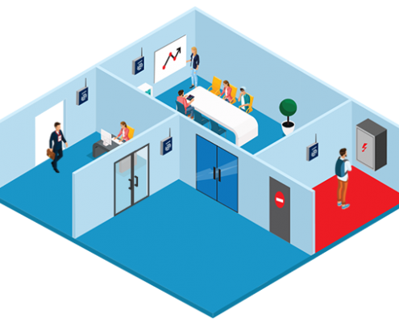
Indoor Localization Applications
Indoor localization system are widely used in:
Indoor navigation
Personal tracking
Asset tracking
3

Slide 4

Indoor Localization Technologies
Indoor localization system are using:
BLE (Bluetooth Low Energy)
WiFi
UWB (Ultra-wideband)
4

Slide 5
Outline
Introduction
Existing Approaches
Overview of SnapLoc
Proposed Method
Design Rational of SnapLoc
Improving Timestamp Resolution
Evaluation
Conclusion
5

Slide 6

Time of Flight (TOF)
A2
Limitations
Large message overhead
High computational burden on tag
A1
2
4
3
1
T
6
7
A3
5
8
A4
Vasisht, Deepak, Swarun Kumar, and Dina Katabi. "Decimeter-level localization with a single WiFi access point." 13th {USENIX} Symposium on Networked Systems Design and Implementation ({NSDI} 16). 2016.
6

Slide 7
Time Difference of Arrival (TDOA)
A2
Limitations
Need for tight synchronization between anchors
Require specific timeslots to avoid collisions
A1
3
2
1
1
T
4
1
A3
1
5
A4
Tiemann et al. 2016. Atlas: An Open-Source TDOA-based Ultra-Wideband Localization System. In Proceedings of the IPIN Conference.
7

Slide 8
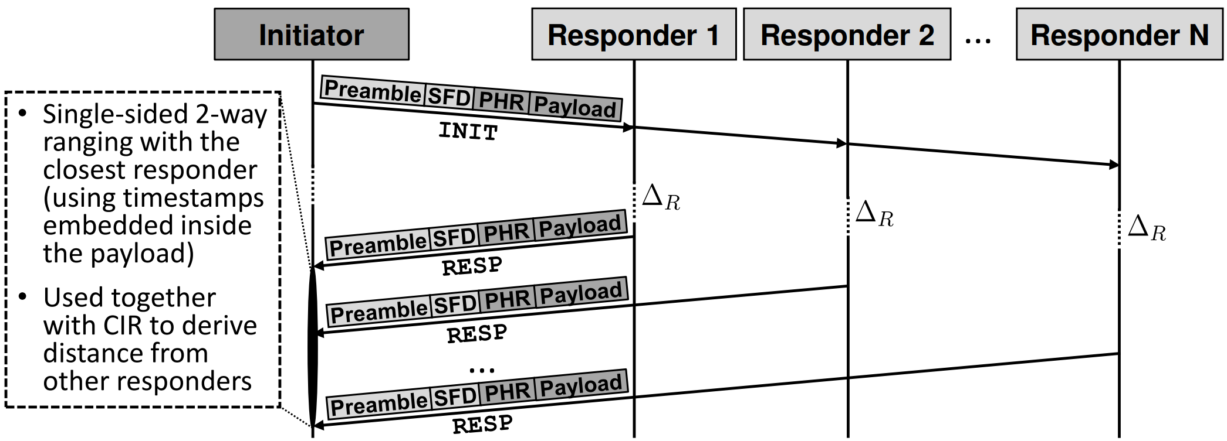
Concurrent Ranging
Signal messages stored in the Payload
(Figure 2(a) at p64)
P. Corbalán et al. 2018. Concurrent Ranging in UWB Radios: Experimental
Evidence, Challenges, and Opportunities. In Proc. of the 15th EWSN Conference.
8

Slide 9

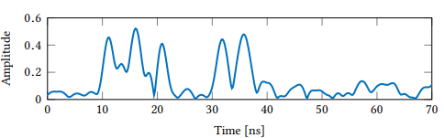
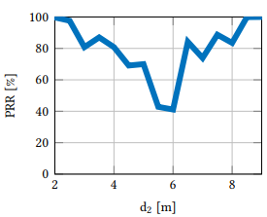
Limitations of Concurrent Ranging
Hard to discern from strong multipath component
High possibility of packet lost / payload corruption
T
RESP message? / Strong MPCs?
(Figure 1(b) at p63)
Figure 2(b) at p64
9

Slide 10
Limitations of Existing Approaches
TOF
Large message overhead
High computational burden on tag
Need for tight synchronization between anchors
Require specific timeslots to avoid collisions
Hard to discern from strong multipath component
High possibility of packet lost / payload corruption
TDOA
TDOA
10

Slide 11
Outline
Introduction
Existing Approaches
Proposed Method
Overview of SnapLoc
Improving Timestamp Resolution
Evaluation
Conclusion
11

Slide 12
Objective of SnapLoc
Allow system to scale in terms of tags density
Achieve high localization accuracy
12

Slide 13
Overview of SnapLoc
Correctly identifying multiple responses
Estimate the TDOA by exploiting CIR information only
Allow an anchor-initiated approach
Reliable responses detection
Localization Algorithms
Implementation
13

Slide 14

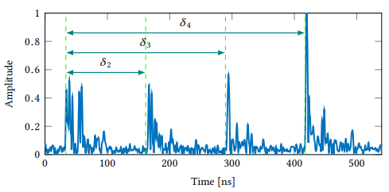

Correctly Identifying Multiple Responses
Setting individual delay for each responder, $δ_{i}=\left(ⅈ−1\right)α$, α = 128 ns
(Previous limitation: Hard to discern from strong multipath component)
(Figure 4 at p65)
14

Slide 15
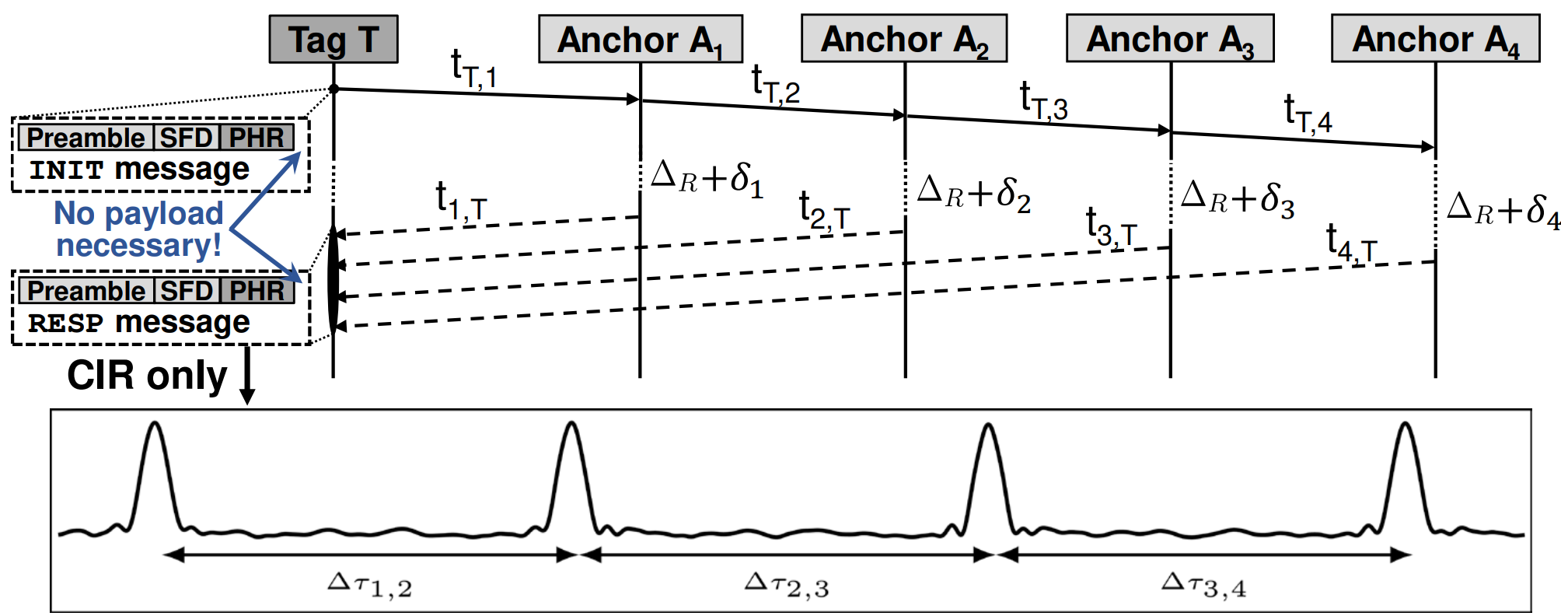
Estimate The TDOA By CIR Information Only
The use of information that is only contained in a packet’s preamble
(Previous limitation: High possibility of packet lost / payload corruption)
Limit the scalability of the system
(Figure 3(b) at p65)
15

Slide 16
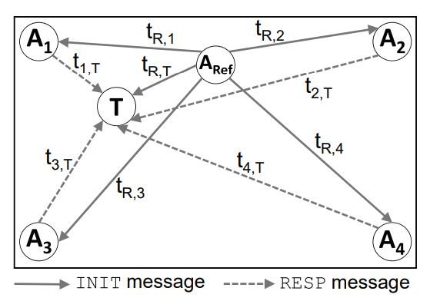
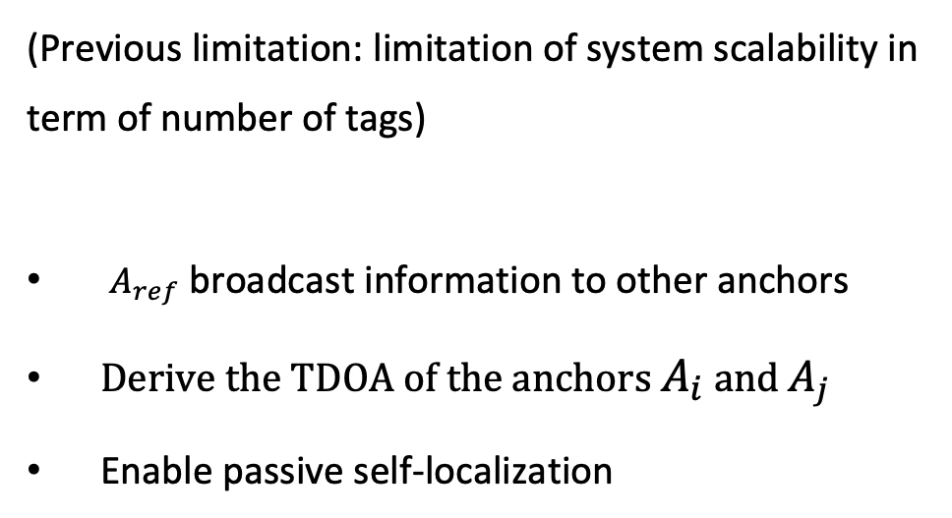
Anchor-initiated Approach
(Previous limitation: limitation of system scalability in term of number of tags)
$A_{ref}$ broadcast information to other anchors
Derive the TDOA of the anchors $A_{i}$ and $A_{j}$
Enable passive self-localization
(Figure 5 at p66)
16

Slide 17
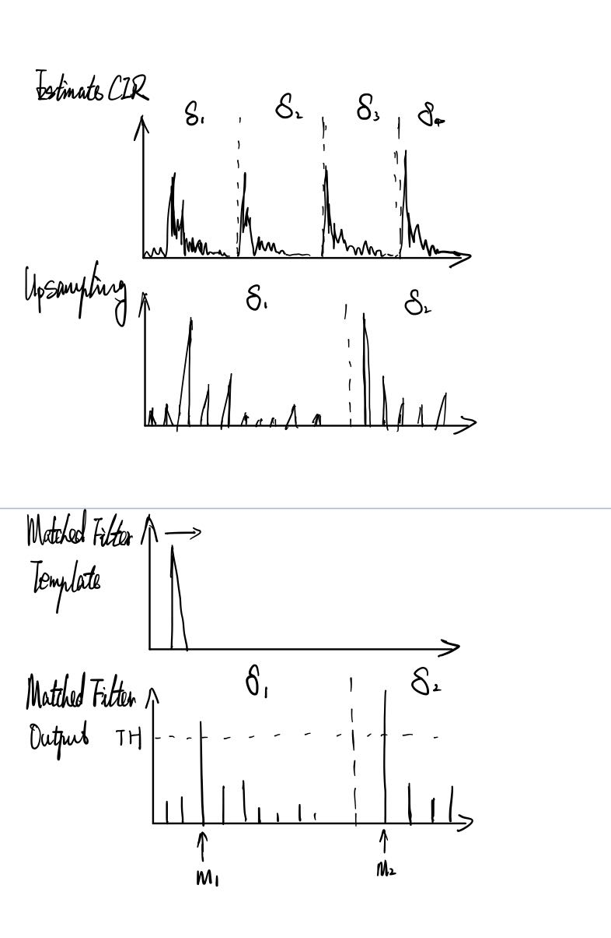

Reliable Responses Detection
Step 2
Step 2
Step 3
Step 1
Step 3
Time difference of responses: ∆${\overset{^}{\text{τ}}}_{i,j}$ = ($m_{j}$- $m_{i}$)(Ts/L)
17

Slide 18

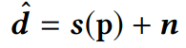
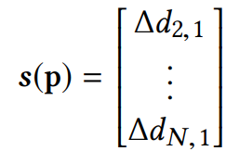
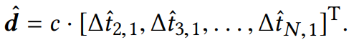

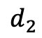
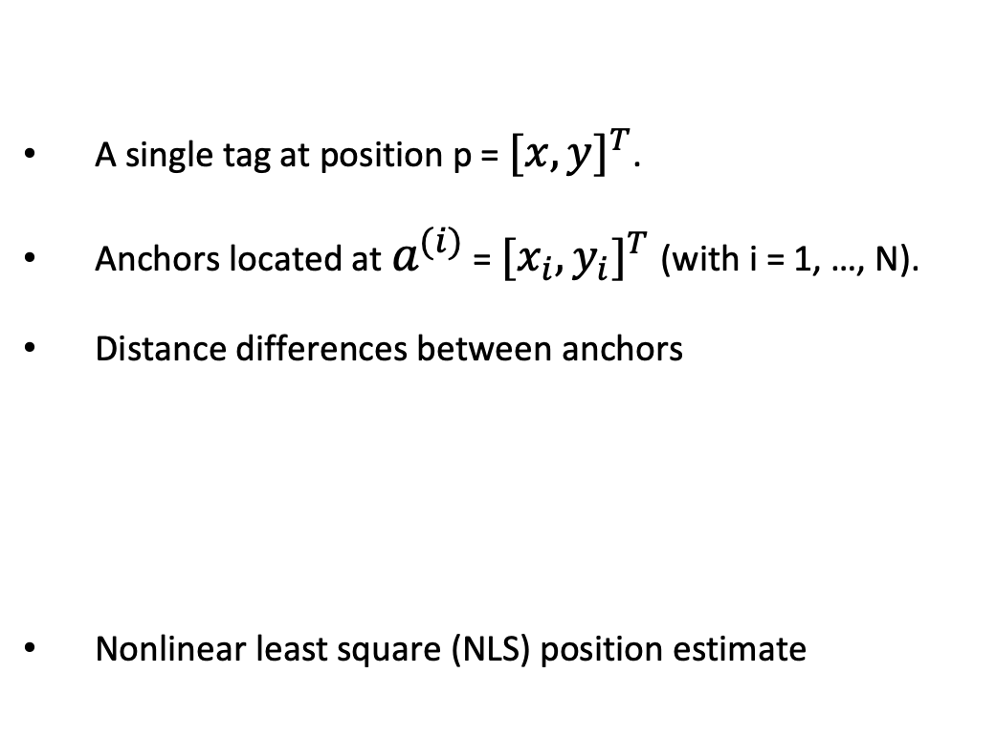
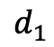

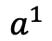
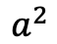
Localization Algorithm
A single tag at position p = ${[x,y]}^{T}$.
Anchors located at $a^{(i)}$ = ${{[x}_{i},y_{i}]}^{T}$(with i = 1, …, N).
Distance differences between anchors
Nonlinear least square (NLS) position estimate
p
T
$$d_{2}$$
A2
$$d_{1}$$
$$a^{1}$$
$$a^{2}$$
$${∆d}_{2,1}=\sqrt{{(x_{2}−x)}^{2}+{(y_{2}−y)}^{2}}−\sqrt{{(x_{1}−x)}^{2}+{(y_{1}−y)}^{2}}$$
18

Slide 19
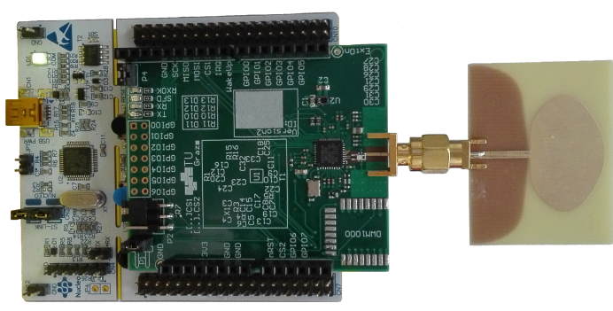
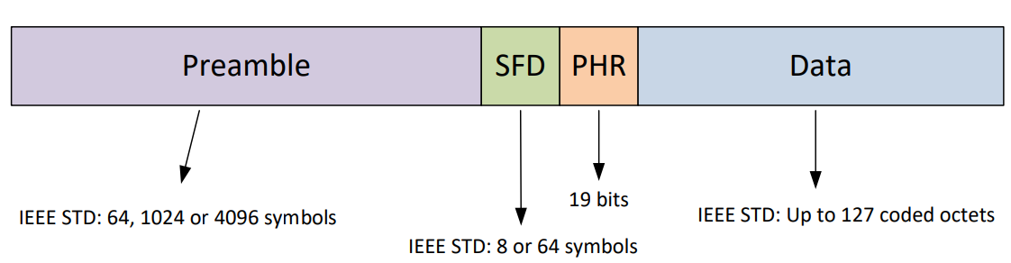
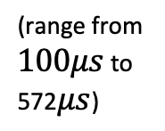
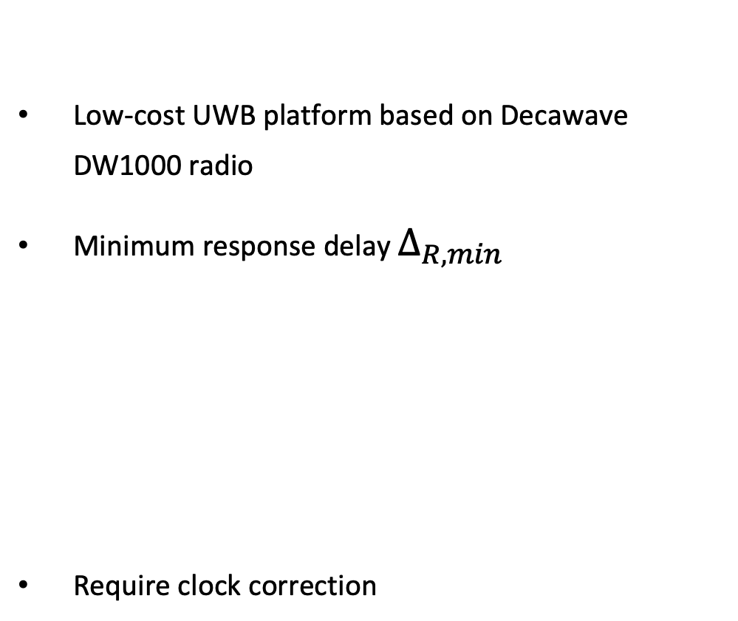
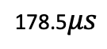

Implementation
Low-cost UWB platform based on Decawave DW1000 radio
Minimum response delay $∆_{R,min}$
Require clock correction
Tag
(Figure 6 at p67)
$$∆_{R,min}={(T}_{PHR}^{INIT}+T_{data}^{INIT}+T_{preamble}^{RESP}+T_{SFD}^{RESP})+ T_{switch}$$
178.5$μs$
(range from $100μs$ to 572$μs$)
19

Slide 20
Outline
Introduction
Existing Approaches
Overview of SnapLoc
Proposed Method
Design Rational of SnapLoc
Improving Timestamp Resolution
Evaluation
Conclusion
20

Slide 21
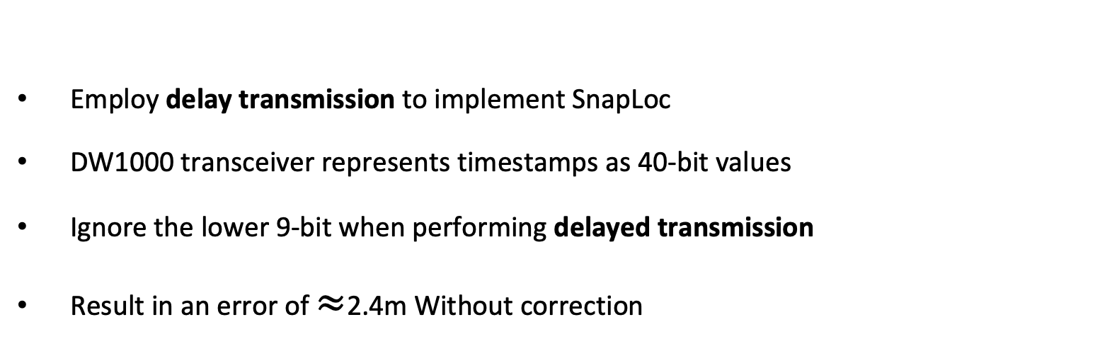
Improving Timestamp Resolution
Employ delay transmission to implement SnapLoc
DW1000 transceiver represents timestamps as 40-bit values
Ignore the lower 9-bit when performing delayed transmission
Result in an error of $≈$2.4m Without correction
21

Slide 22



Wired Correction
System tracks the lost 9-bit
Correct the timestamps from previous CIR
$$A_{REF}$$
Missing transmit timestamp
$$T$$
backbone
Introduce a delay of one initialization interval $T_{INIT}$
22

Slide 23

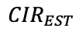

Wireless Correction
Reference anchor listens to the responses from other anchors
Wireless correction performance is limited by sampling period
A2
A1
$${CIR}_{EST}$$
${Error=CIR}_{TRUE}−{CIR}_{EST}$
$$A_{REF}$$
A3
A4
23

Slide 24
Outline
Introduction
Existing Approaches
Overview of SnapLoc
Proposed Method
Design Rational of SnapLoc
Improving Timestamp Resolution
Evaluation
Conclusion
24

Slide 25
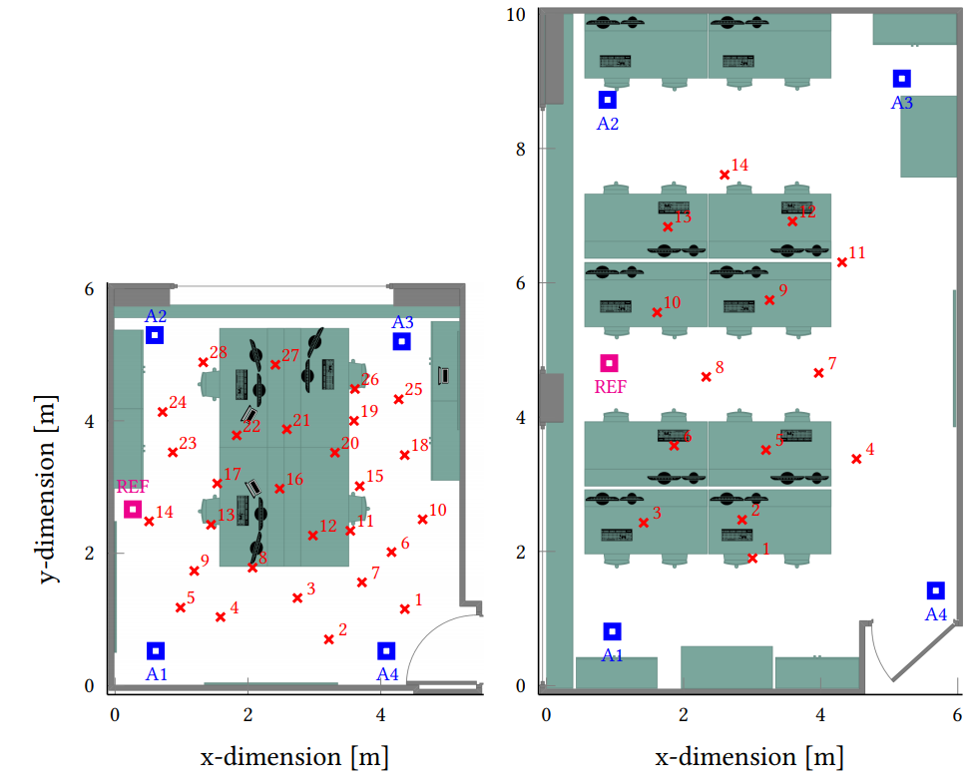
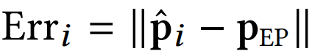
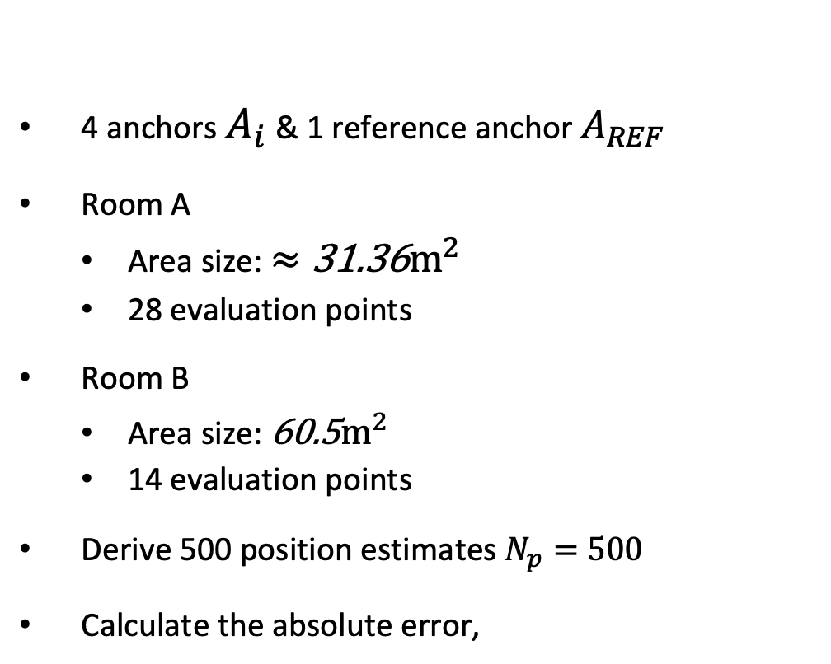
Experimental Setup
4 anchors $A_{i}$ & 1 reference anchor $A_{REF}$
Room A
Area size: $≈{\text{31.36}m}^{2}$
28 evaluation points
Room B
Area size: ${\text{60.5}m}^{2}$
14 evaluation points
Derive 500 position estimates $N_{p}=500$
Calculate the absolute error,
Room A
Room B
(Figure 7(a) (b) at p69)
25

Slide 26
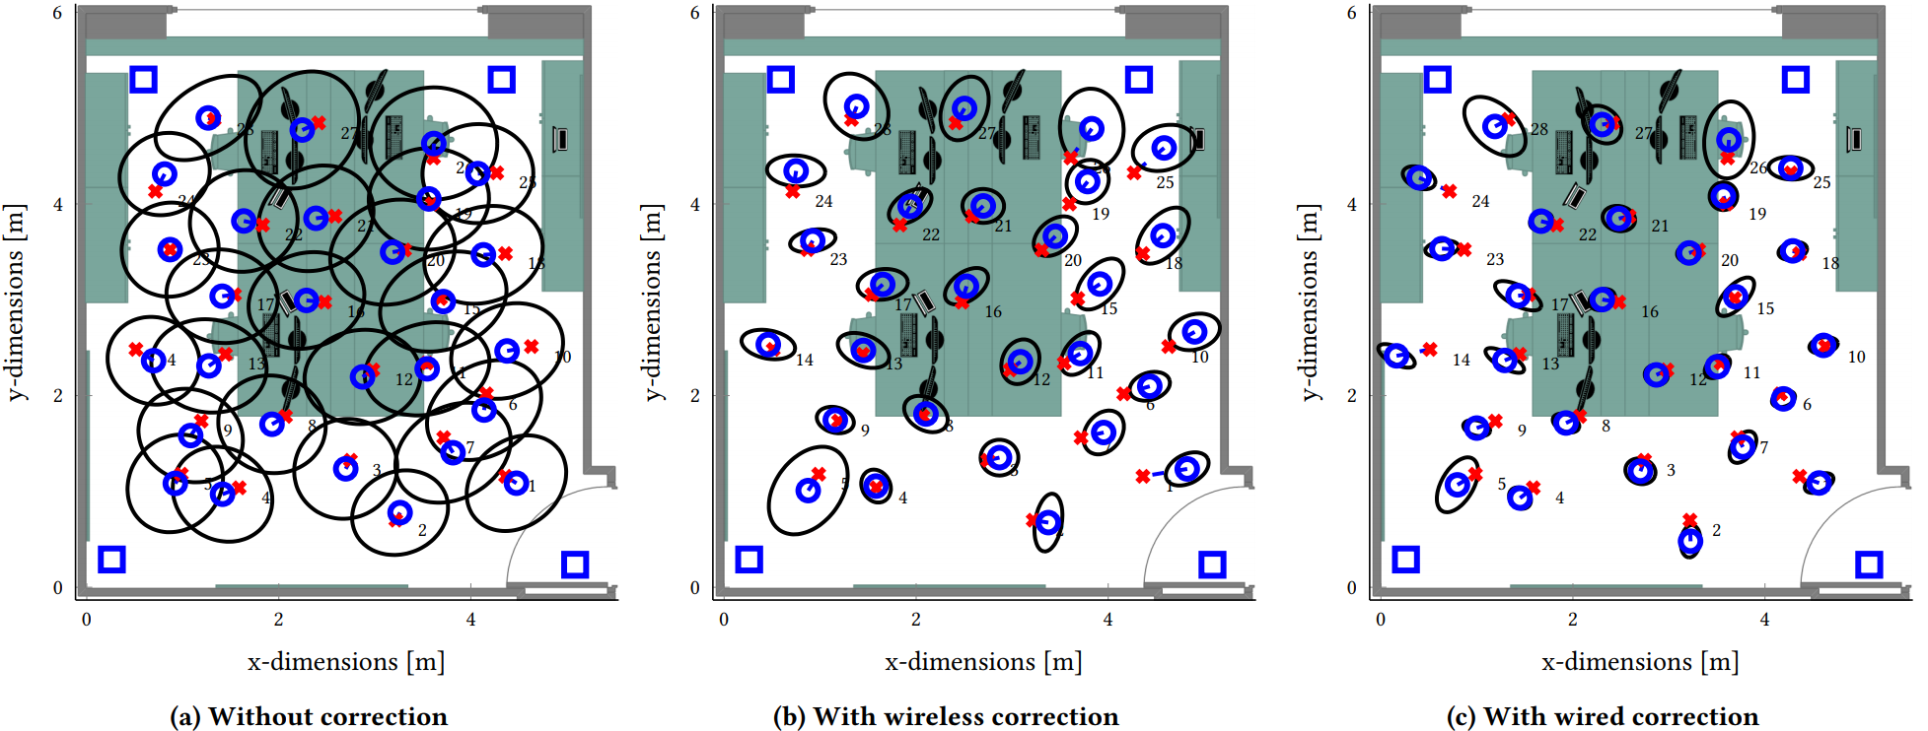
Localization Accuracy
Error ellipses
Bias values: blue circles
Standard deviation: black circles
SnapLoc combined with wired correction has the best performance
(Figure 8(a) (b) (c) at p70)
26

Slide 27
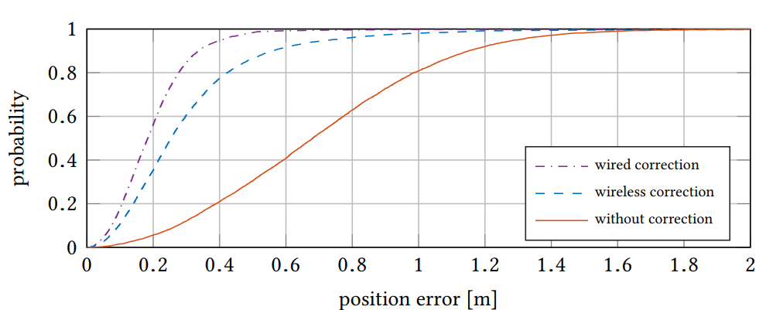
Performance In Office Room
 | Without correction | Wired correction | Wireless correction
90% error (m) | 1.15 | 0.337 | 0.558
Median error (m) | 0.68 | 0.184 | 0.254
0.9
(Figure 9 (a) at p71)
27

Slide 28
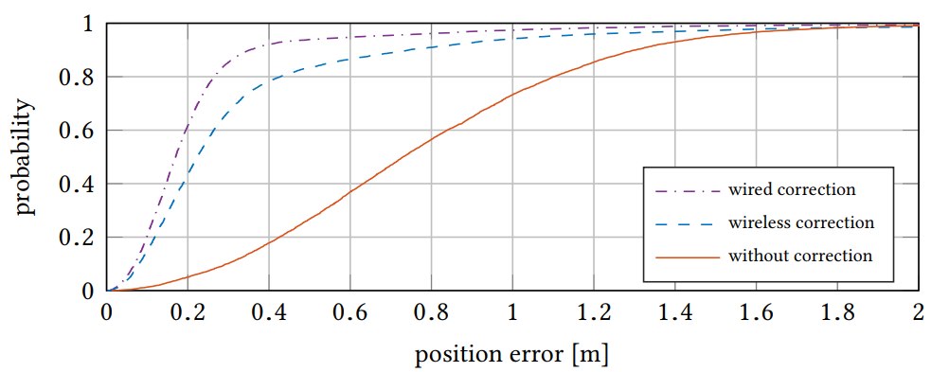
Performance In Larger Lab Room
 | Without correction | Wired correction | Wireless correction
90% error (m) | 1.30 | 0.352 | 0.74
Median error (m) | 0.73 | 0.17 | 0.223
(Figure 9 (b) at p71)
28

Slide 29
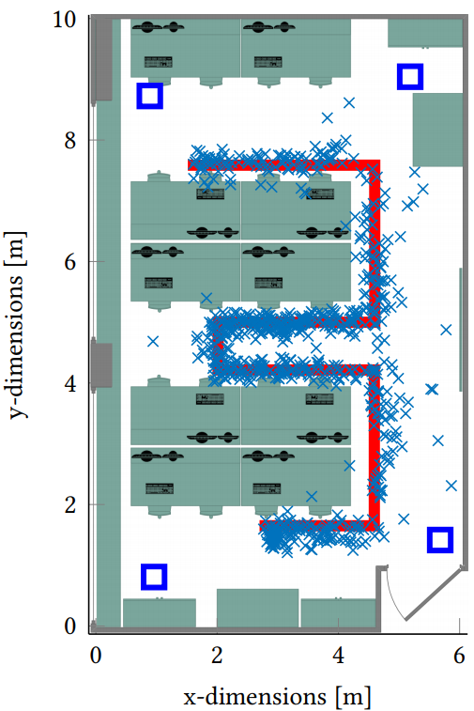
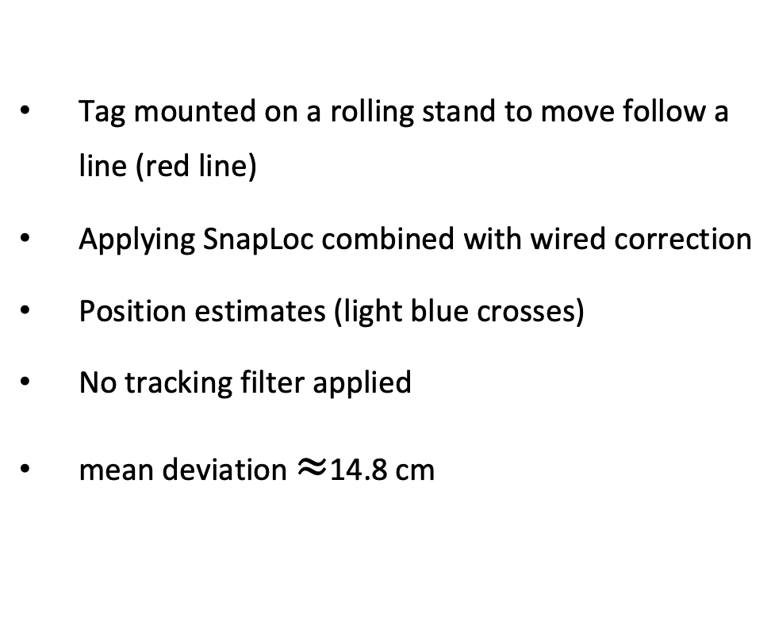
Free Movement Accuracy
Tag mounted on a rolling stand to move follow a line (red line)
Applying SnapLoc combined with wired correction
Position estimates (light blue crosses)
No tracking filter applied
mean deviation $≈$14.8 cm
(Figure 10 at p71)
29

Slide 30
Outline
Introduction
Existing Approaches
Overview of SnapLoc
Proposed Method
Design Rational of SnapLoc
Improving Timestamp Resolution
Evaluation
Conclusion
30

Slide 31
Conclusion
SnapLoc applies a modification of the concurrent ranging to a TDOA-based approach
SnapLoc supports an unlimited number tags to passive self-localize
Implement SnapLoc on a low-cost platform
SnapLoc achieves a decimeter-level accuracy
31

Slide 32
Review
Strengths
Allow system to scale
Achieve decimeter-level positioning accuracy
Weaknesses
Power consumption still much higher than BLE (82.4 µJ vs. 10.1 µJ)
Tags remain anonymous because of passive self-localization
Not showing the accuracy of SnapLoc without clock correction
Lindemann, Alexander, et al. "Indoor Positioning: A Comparison of WiFi and Bluetooth Low Energy for Region Monitoring." HEALTHINF. 2016.
32

Slide 33
Thank You!

